Slide 1
Basics of Statistics
Lecture 1b

Slide 2
Probability
How likely it is that some event will happen?
Idea:
Experiment
Outcomes (sample points) O₁, O₂,… O_{n}
Sample space Ω
Event A
Probability function P: Events →[0,1]

Slide 3

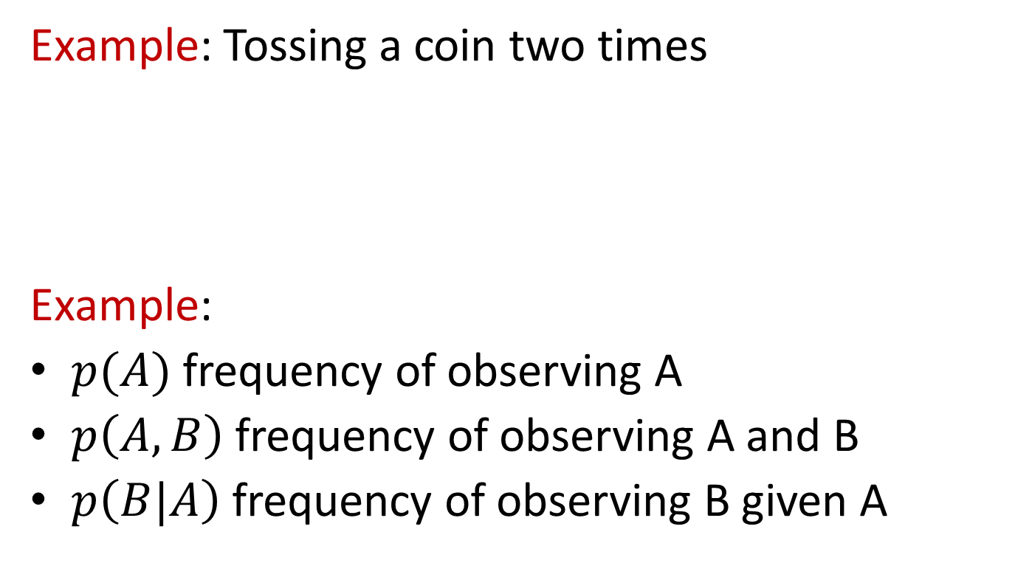
Probability
Example: Tossing a coin two times
Example:
$p(A)$ frequency of observing A
$p\left(A,B\right)$ frequency of observing A and B
$p\left(B|A\right)$ frequency of observing B given A
http://cdn.toonvectors.com/images/35/10267/toonvectors-10267-940.jpg

Slide 4
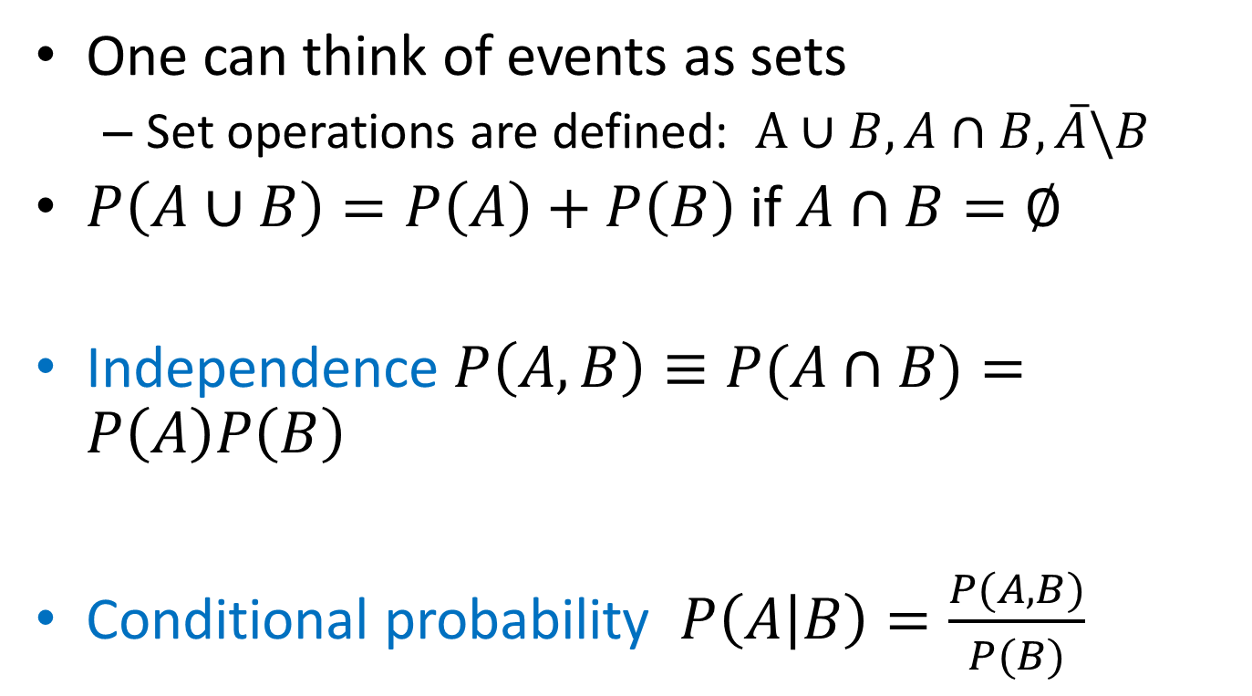
Properties and definitions
One can think of events as sets
Set operations are defined: $A∪B, A∩B,\overline{A}\backslash B$
$P\left(A∪B\right)=P\left(A\right)+P\left(B\right)$ if $A∩B=∅$
Independence $P\left(A,B\right)≡P(A∩B)=P\left(A\right)P\left(B\right)$
Conditional probability $P\left(A | B\right)=\frac{P(A,B)}{P(B)}$

Slide 5
Bayes theorem
Example:
We have constructed spam filter that
identifies spam mail as spam with probability 0.95
Identifies usual mail as spam with probability 0.005
This kind of spam occurs once in 100,000 mails
If we found that a letter is a spam, what is the probability that it is actually a spam?

Slide 6
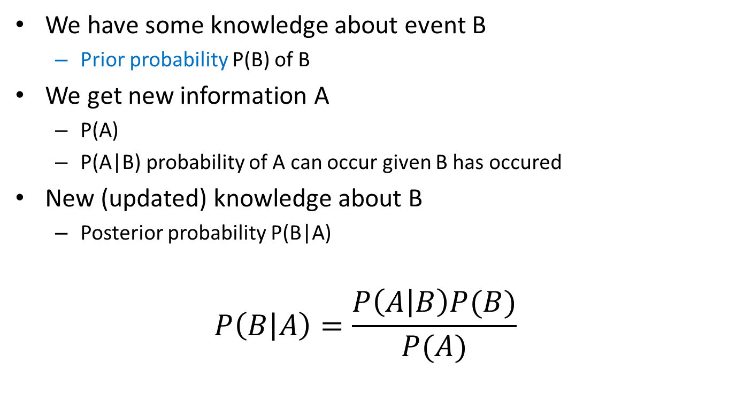
Bayes theorem
We have some knowledge about event B
Prior probability P(B) of B
We get new information A
P(A)
P(A|B) probability of A can occur given B has occured
New (updated) knowledge about B
Posterior probability P(B|A)
$$P\left(B | A\right)=\frac{P\left(A | B\right)P(B)}{P(A)}$$

Slide 7
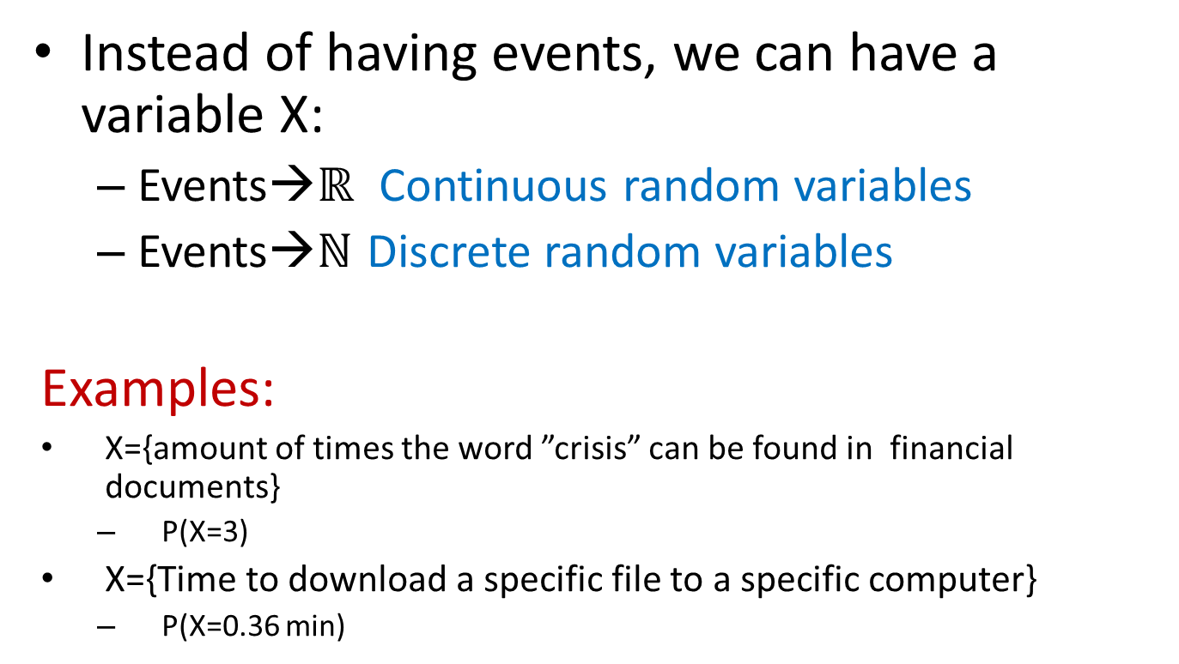
Random variables
Instead of having events, we can have a variable X:
Events→$ℝ$ Continuous random variables
Events→$ℕ$ Discrete random variables
Examples:
X={amount of times the word ”crisis” can be found in financial documents}
P(X=3)
X={Time to download a specific file to a specific computer}
P(X=0.36 min)

Slide 8
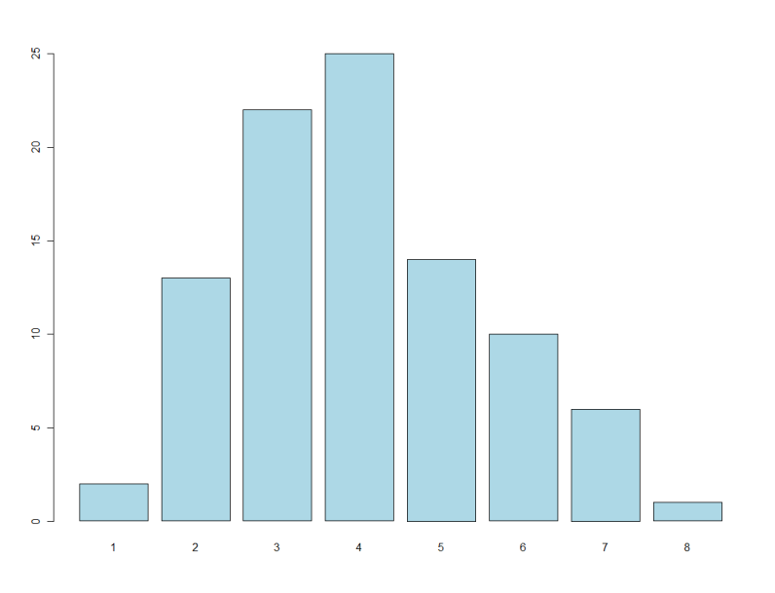
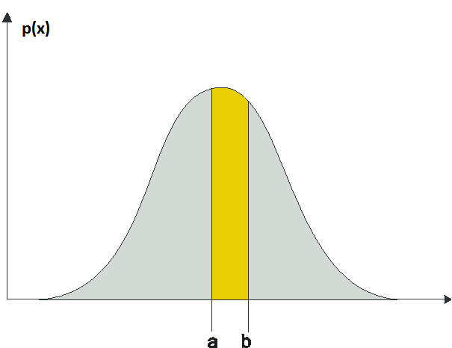
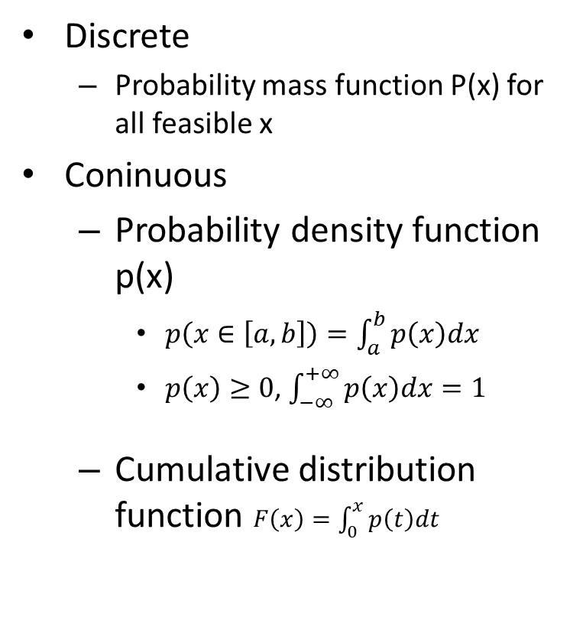
Distributions
Discrete
Probability mass function P(x) for all feasible x
Coninuous
Probability density function p(x)
$p\left(x∈\left[a,b\right]\right)=\int_{a}^{b}{p\left(x\right)dx}$
$p\left(x\right)≥0$, $\int_{−∞}^{+∞}{p\left(x\right)dx}=1$
Cumulative distribution function $F\left(x\right)=\int_{0}^{x}{p\left(t\right)dt}$

Slide 9
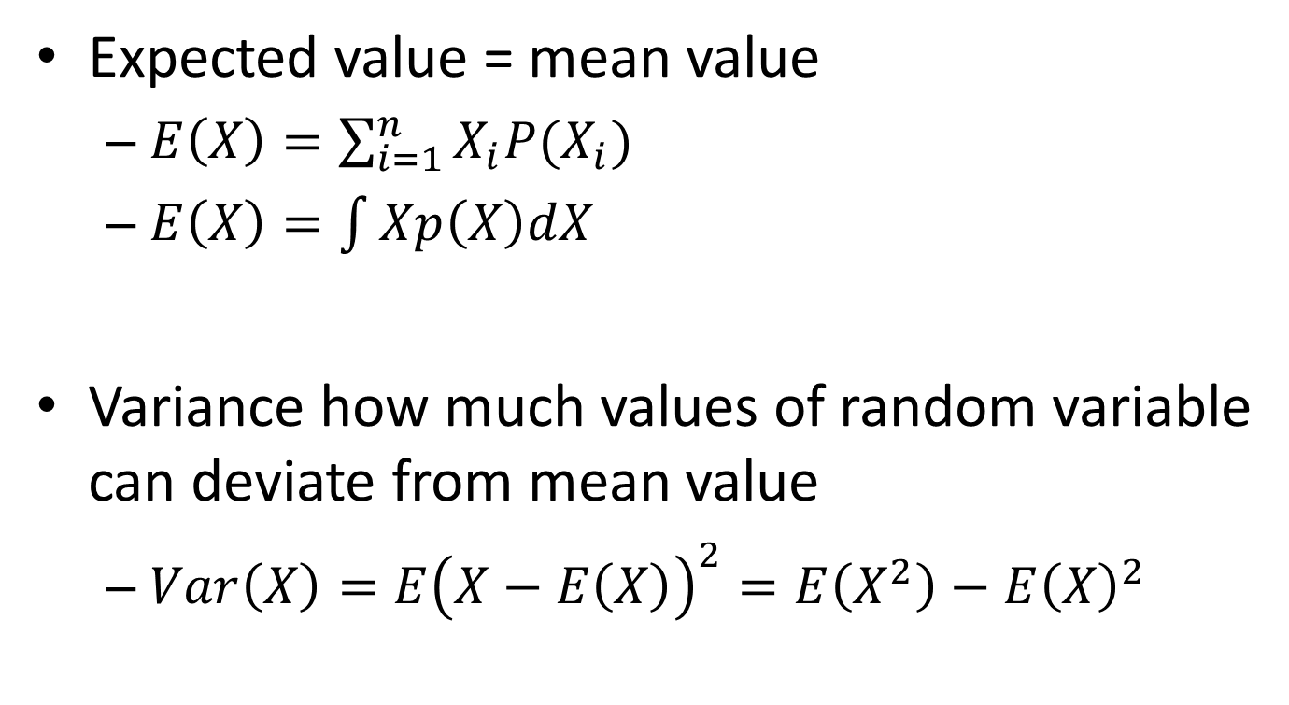
Expected value and variance
Expected value = mean value
$E\left(X\right)=\sum_{i=1}^{n}{X_{i}P(X_{i})}$
$E\left(X\right)=\int{Xp\left(X\right)dX}$
Variance how much values of random variable can deviate from mean value
$Var\left(X\right)=E{\left(X−E\left(X\right)\right)}^{2}=E\left(X^{2}\right)−E{\left(X\right)}^{2}$

Slide 10
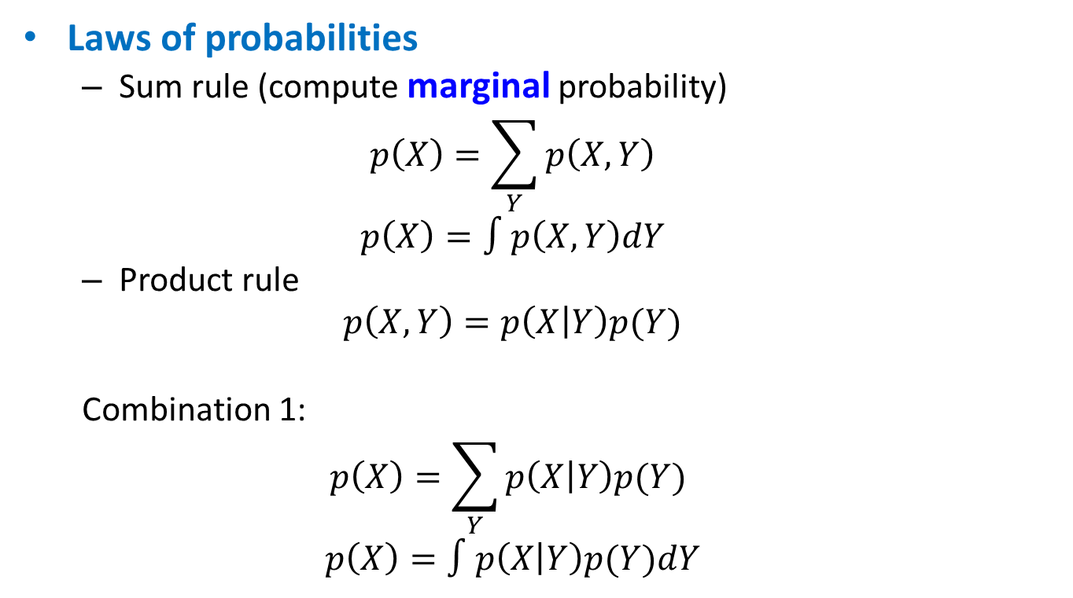
Probabilities
Laws of probabilities
Sum rule (compute marginal probability)
$$p\left(X\right)=\sum_{Y}{p\left(X,Y\right)}$$
$$p\left(X\right)=∫p\left(X,Y\right)dY$$
Product rule
$$p\left(X,Y\right)=p\left(X | Y\right)p(Y)$$
Combination 1:
$$p\left(X\right)=\sum_{Y}{p\left(X | Y\right)p(Y) }$$
$$p\left(X\right)=∫p\left(X | Y\right)p(Y)dY$$

Slide 11
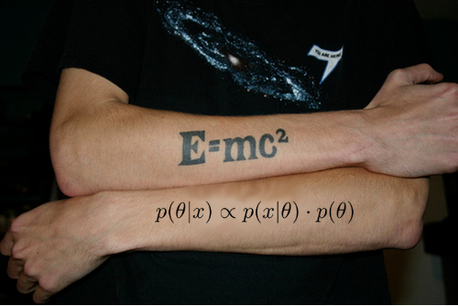
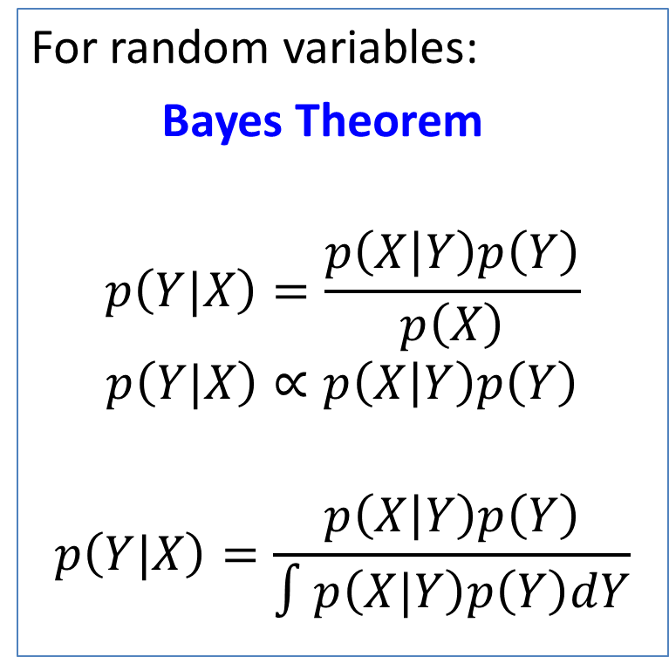
Bayes theorem
For random variables:
Bayes Theorem
$$p\left(Y|X\right)=\frac{p\left(X | Y\right)p\left(Y\right)}{p\left(X\right)}$$
$$p\left(Y|X\right)∝p\left(X | Y\right)p\left(Y\right)$$
$$p\left(Y|X\right)=\frac{p\left(X | Y\right)p\left(Y\right)}{∫p\left(X|Y\right)p\left(Y\right)dY}$$

Slide 12
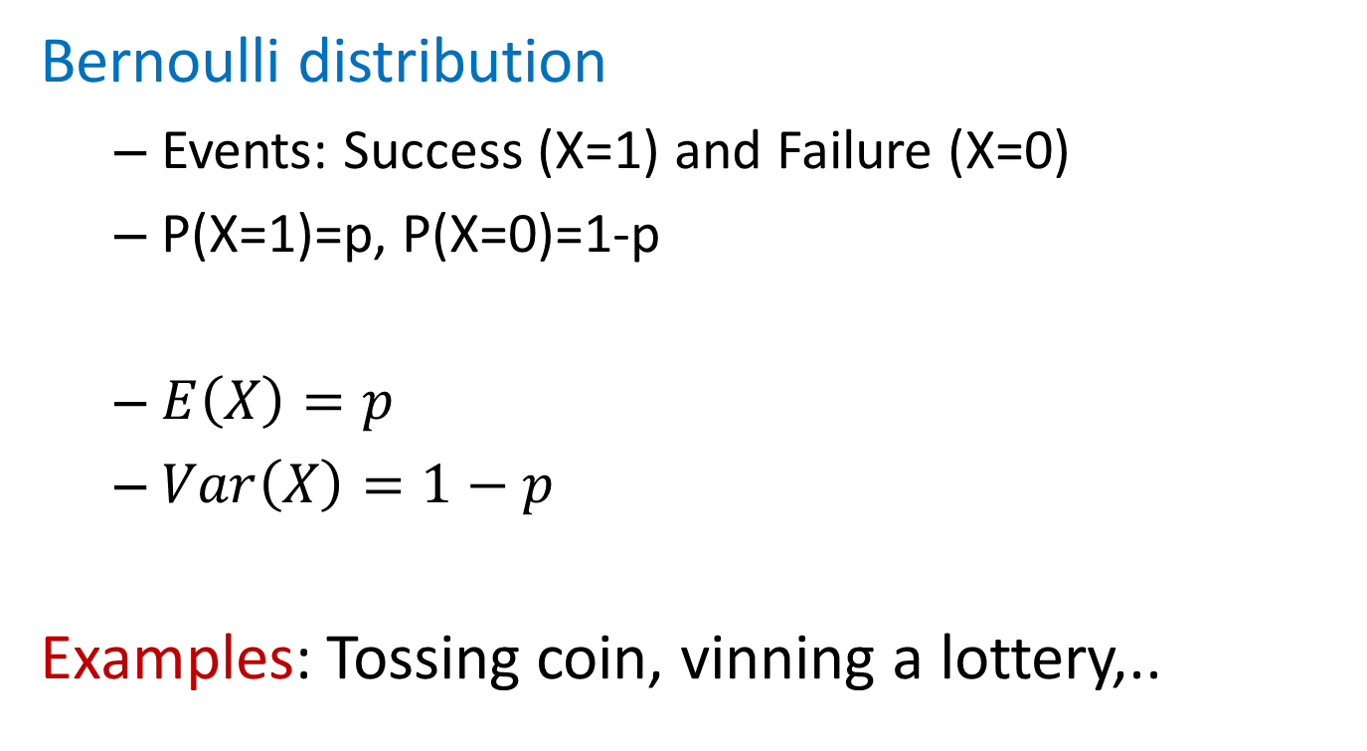
Some conventional distributions
Bernoulli distribution
Events: Success (X=1) and Failure (X=0)
P(X=1)=p, P(X=0)=1-p
$E\left(X\right)=p$
$Var\left(X\right)=1−p$
Examples: Tossing coin, vinning a lottery,..

Slide 13
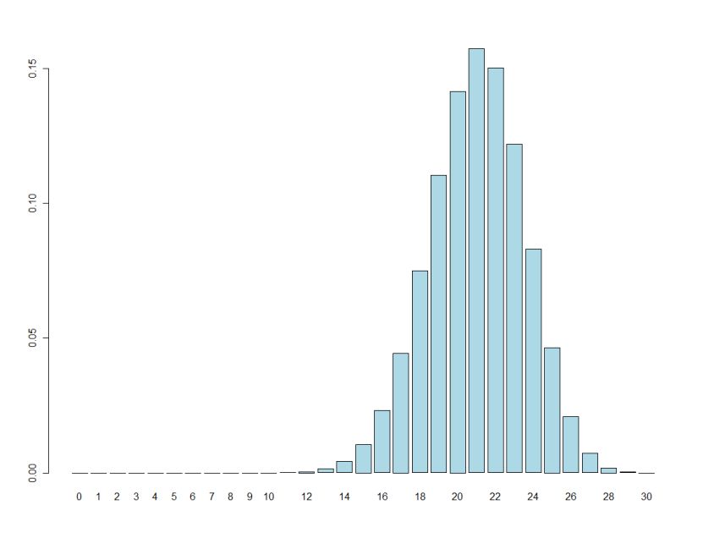
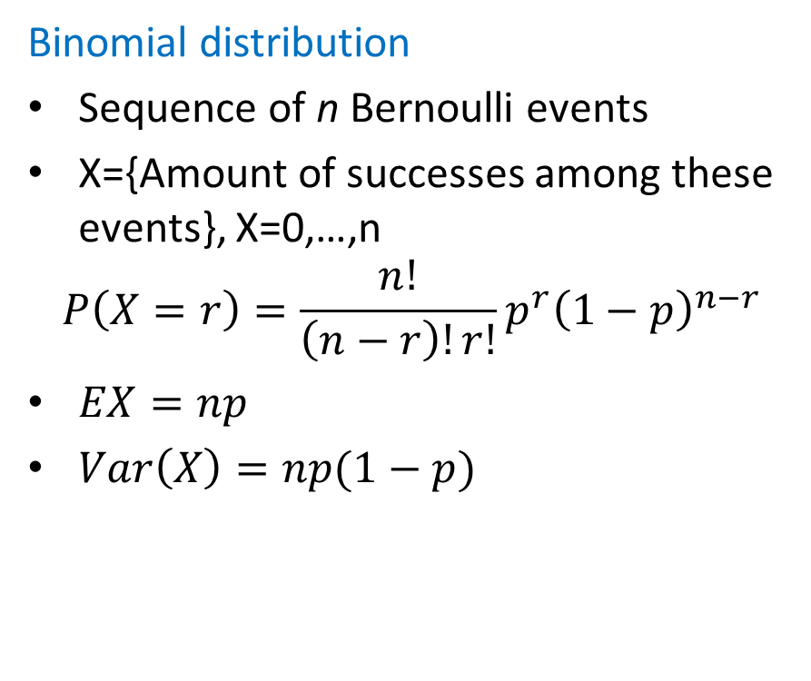
Some conventional distributions
Binomial distribution
Sequence of n Bernoulli events
X={Amount of successes among these events}, X=0,…,n
$$P\left(X=r\right)=\frac{n!}{\left(n−r\right)!r!}p^{r}{\left(1−p\right)}^{n−r}$$
$EX=np$
$Var\left(X\right)=np(1−p)$

Slide 14
Poisson distribution
Customers of a bank n (in theory, endless population)
Probability that a specific person will make a call to the bank between 13.00 and 14.00 a certain day is p
p can be very small if population is large (rare event)
Still, some people will make calls between 13.00 and 14.00 that day, and their amount may be quite big
A known quantity λ=np is mean amount of persons that call between 13.00 and 14.00
X={amount of persons that have called between 13.00 and 14.00}

Slide 15
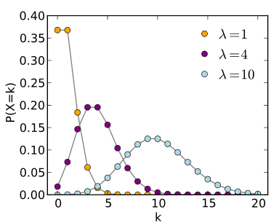
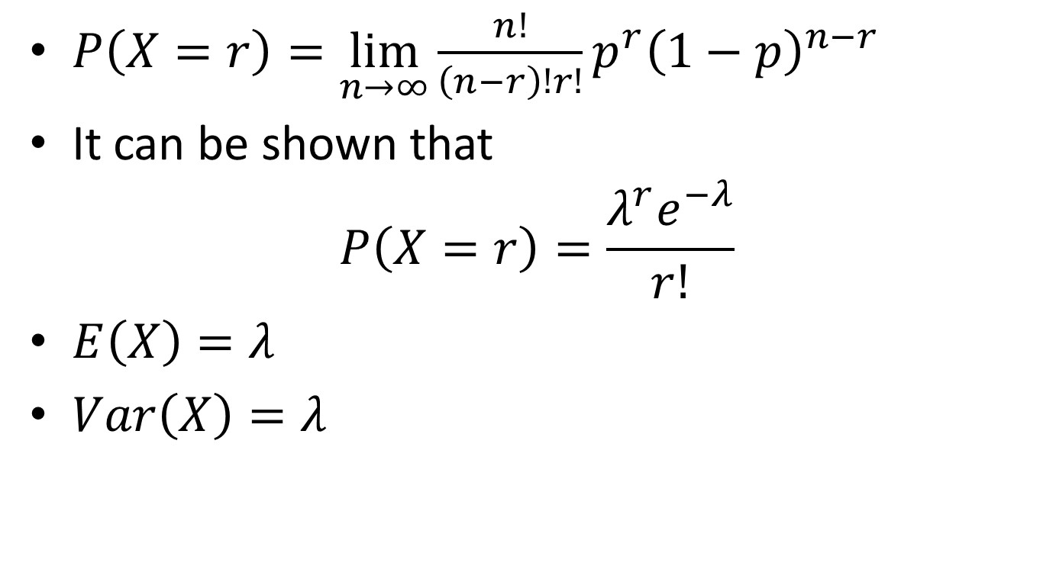
Poisson distribution
$P\left(X=r\right)=\lim_{n→∞}{\frac{n!}{\left(n−r\right)!r!}p^{r}{\left(1−p\right)}^{n−r}}$
It can be shown that
$$P\left(X=r\right)=\frac{λ^{r}e^{−λ}}{r!}$$
$E\left(X\right)=λ$
$Var\left(X\right)=λ$

Slide 16
Poisson distribution
Further properties:
Poisson distribution is a good approximation of the binomial distribution if n >20 and p < 0.05
Excellent approximation if n ≥ 100 and np ≤ 10

Slide 17
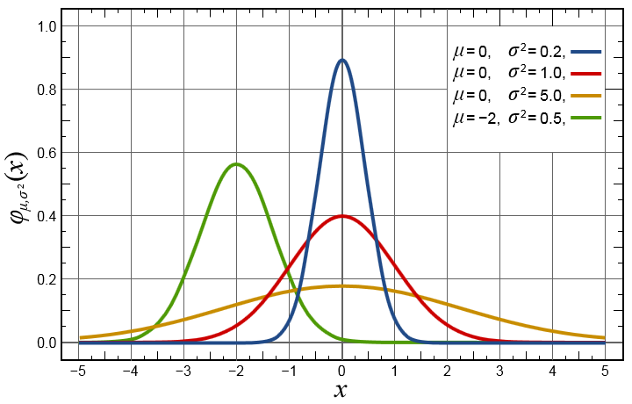
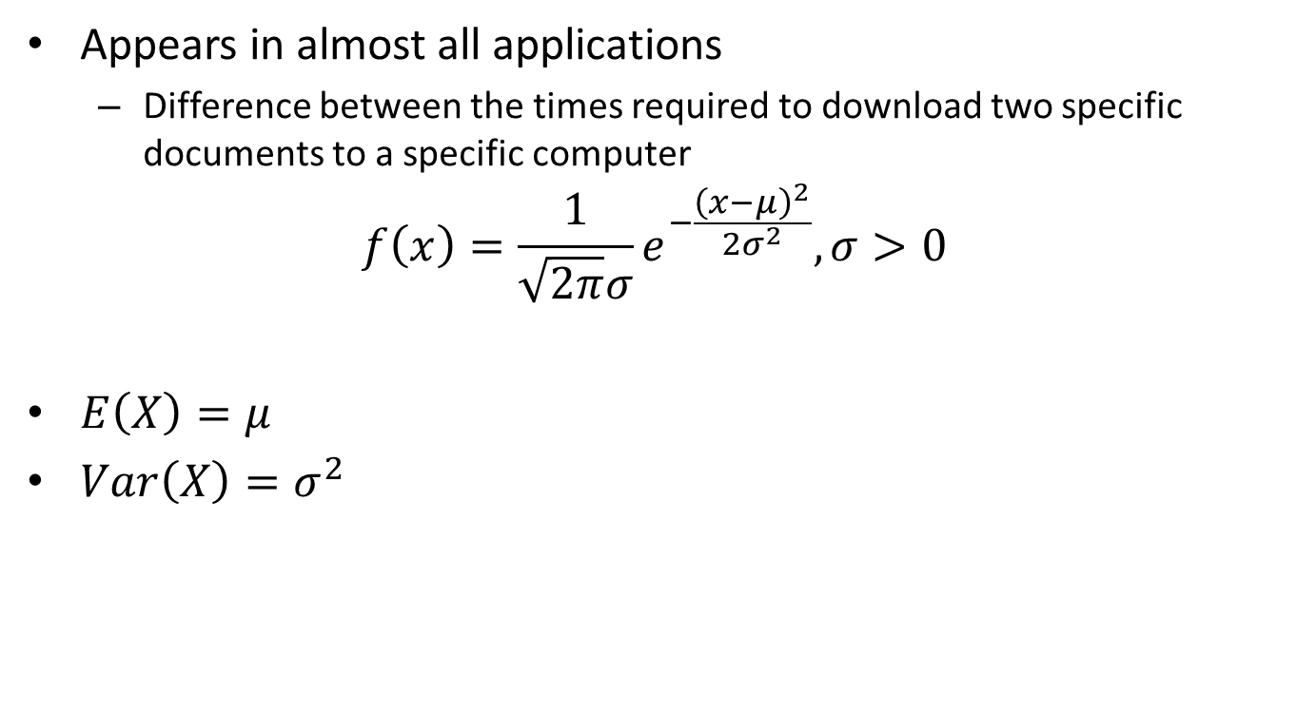
Normal distribution
Appears in almost all applications
Difference between the times required to download two specific documents to a specific computer
$$f\left(x\right)=\frac{1}{\sqrt{2π}σ}e^{−\frac{{\left(x−μ\right)}^{2}}{2σ^{2}}}, σ>0$$
$E\left(X\right)=μ$
$Var\left(X\right)=σ^{2}$

Slide 18
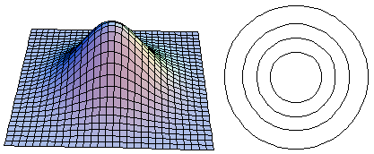
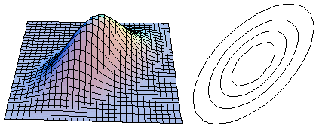
Multivariate distributions
Probability of two variables having certain values at the same time
P.D.F. p(x,y)
Correlation

Slide 19
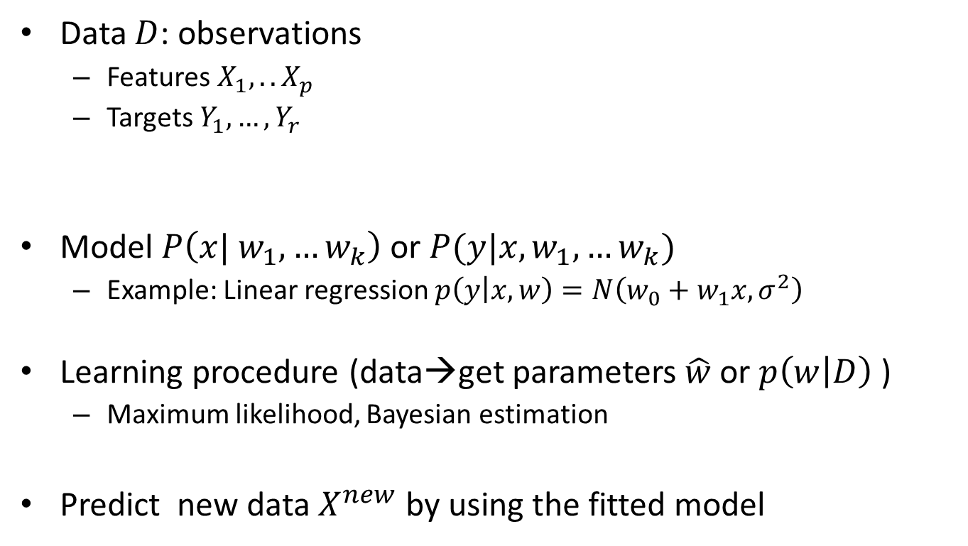
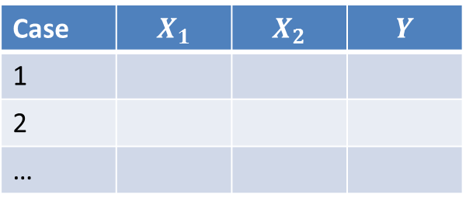
Basic ML ingridients
Data $D$: observations
Features $X_{1},.. X_{p}$
Targets $Y_{1},…{,Y}_{r}$
Model $P\left(x| w_{1},…w_{k}\right)$ or $P(y|x,w_{1},…w_{k})$
Example: Linear regression $p\left(y | x,w\right)=N\left(w_{0}+w_{1}x, σ^{2}\right)$
Learning procedure (data→get parameters $\hat{w}$ or $p\left(w | D\right)$ )
Maximum likelihood, Bayesian estimation
Predict new data $X^{new}$ by using the fitted model
Case | $$X_{1}$$ | $$X_{2}$$ | $$Y$$
1
2
…

Slide 20
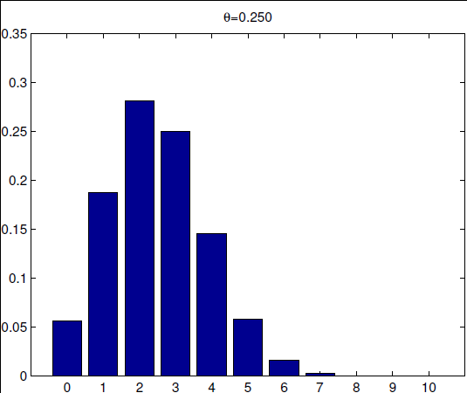
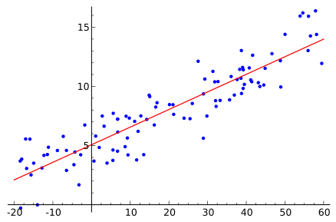


Probabilistic models
A distribution $p\left(x | w\right)$ or $p(y|x, w)$
Example:
$x\sim Bin\left(n, θ\right)$
$y\sim N(α_{0}+α_{1}x, σ^{2})$
$$p\left(x=k | n,θ\right)=\left(\begin{matrix}n \\ k\end{matrix}\right)θ^{k}{\left(1−θ\right)}^{n−k}$$
Learn basic distributions and their properties→PRML, chapter 2!
Source: Wikipedia

Slide 21
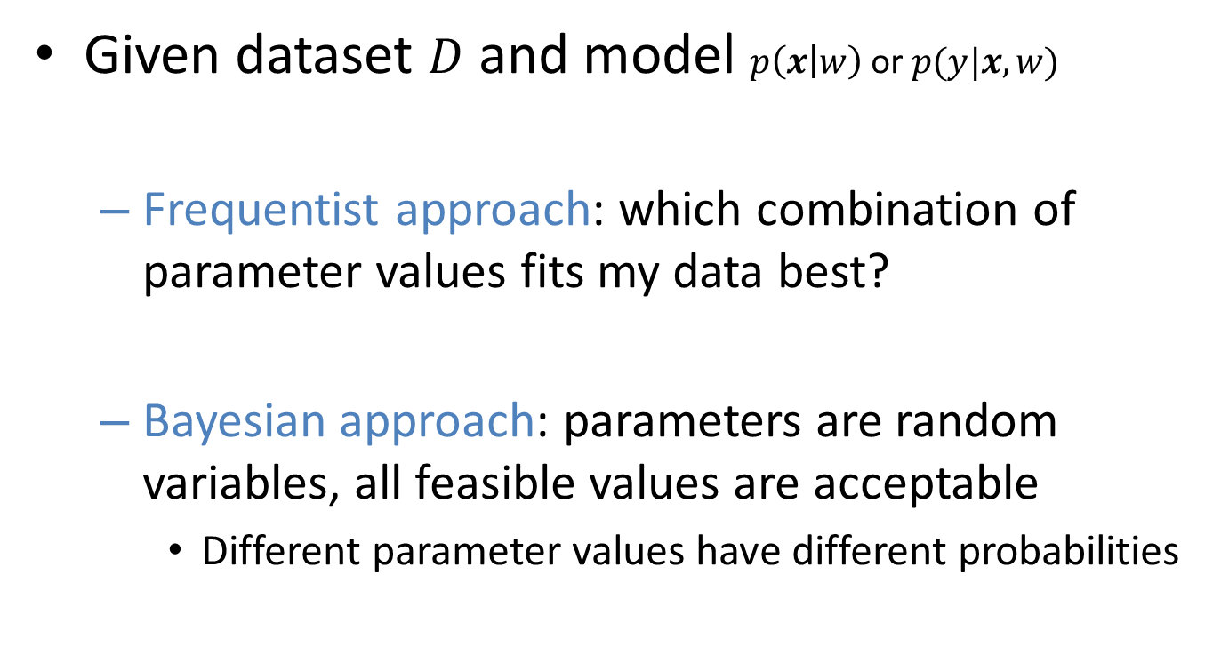
Fitting a model
Given dataset $D$ and model $p\left(x | w\right)$ or $p(y|x, w)$
Frequentist approach: which combination of parameter values fits my data best?
Bayesian approach: parameters are random variables, all feasible values are acceptable
Different parameter values have different probabilities

Slide 22
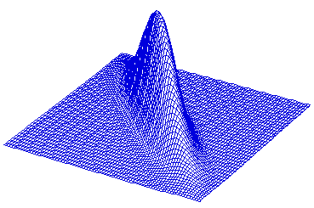
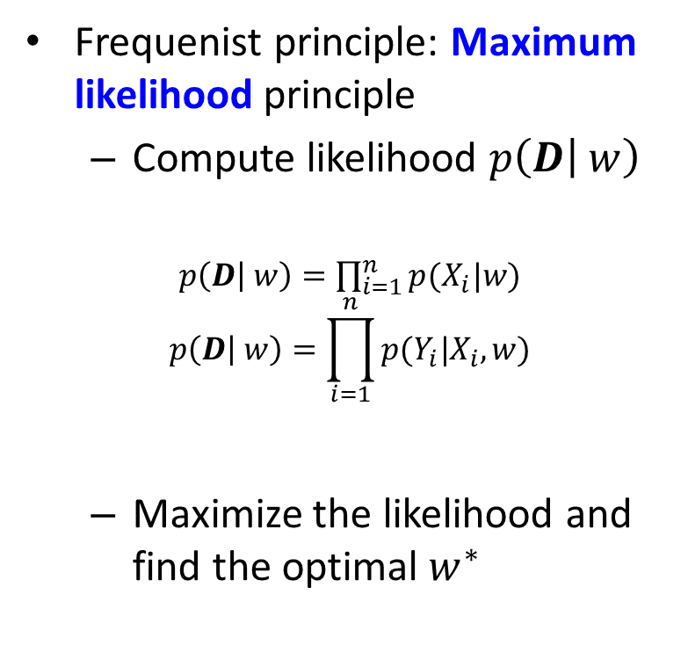
Fitting a model
Frequenist principle: Maximum likelihood principle
Compute likelihood $p\left(D | w\right)$
$p\left(D | w\right)=\prod_{i=1}^{n}{p(X_{i}|w)}$
$$p\left(D | w\right)=\prod_{i=1}^{n}{p(Y_{i}|X_{i},w)}$$
Maximize the likelihood and find the optimal $w^{∗}$

Slide 23
Fitting a model
Remarks:
Likelihood shows how much the chosen parameter value is proper for a specific model and the given data
Normally log-likelihood is used in computations instead
Other alternatives to ML exist…

Slide 24
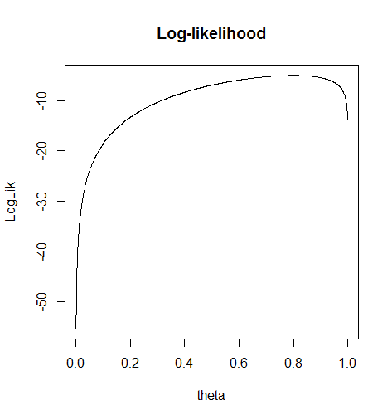

Fitting a model
Example: tossing a coin.
$D=\left\{0,1,1,0,1,1,1,1,1,1,1,1\right\},$
$$p\left(x=1 | θ\right)=θ,p\left(x=0 | θ\right)=1−θ$$

Slide 25
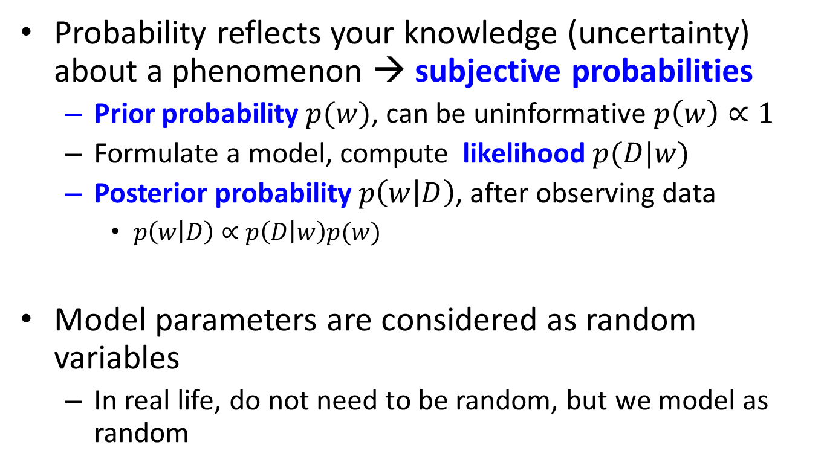
Bayesian probabilities
Probability reflects your knowledge (uncertainty) about a phenomenon → subjective probabilities
Prior probability $p(w)$, can be uninformative $p\left(w\right)∝1$
Formulate a model, compute likelihood $p(D|w)$
Posterior probability $p\left(w | D\right)$, after observing data
$p\left(w | D\right)∝p\left(D | w\right)p(w)$
Model parameters are considered as random variables
In real life, do not need to be random, but we model as random

Slide 26
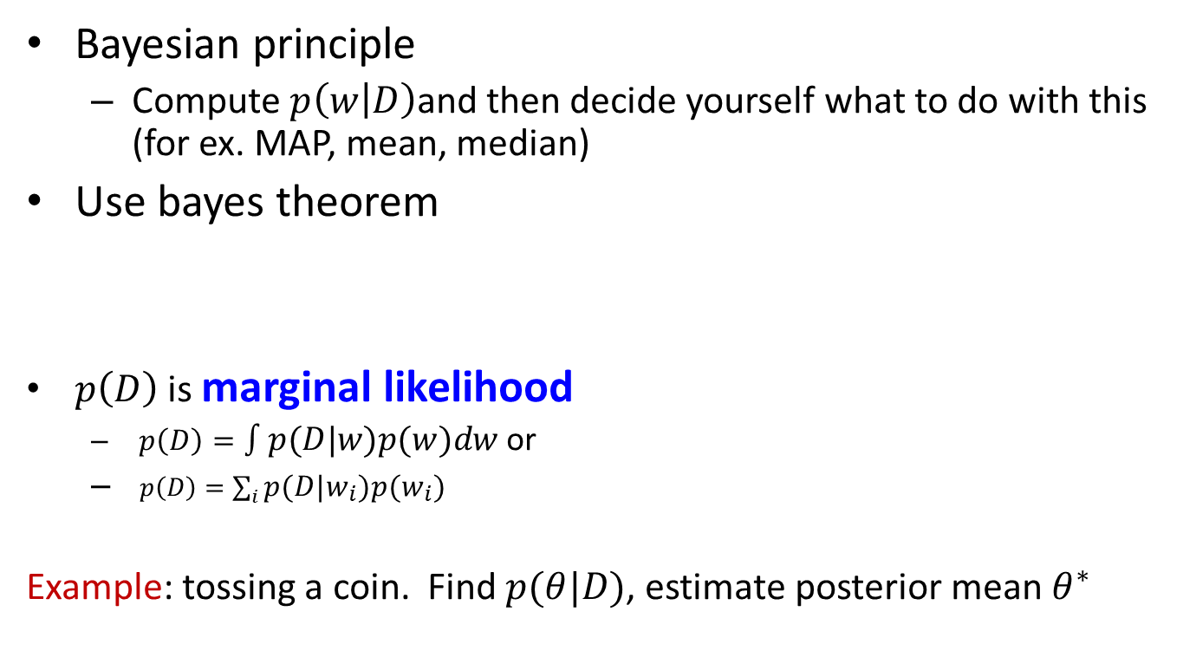
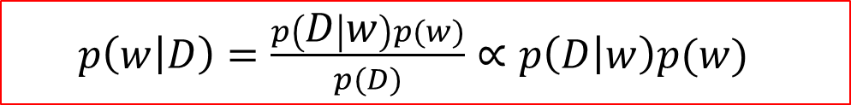
Fitting a model
Bayesian principle
Compute $p\left(w | D\right)$and then decide yourself what to do with this (for ex. MAP, mean, median)
Use bayes theorem
$p\left(D\right)$ is marginal likelihood
$p\left(D\right)=∫p\left(D | w\right)p\left(w\right)dw$ or
$p\left(D\right)=\sum_{i}{p\left(D | w_{i}\right)p\left(w_{i}\right)}$
Example: tossing a coin. Find $p(θ|D)$, estimate posterior mean $θ^{∗}$
$p\left(w | D\right)=\frac{p\left(D | w\right)p(w)}{p(D)}∝p\left(D | w\right)p(w)$

Slide 27
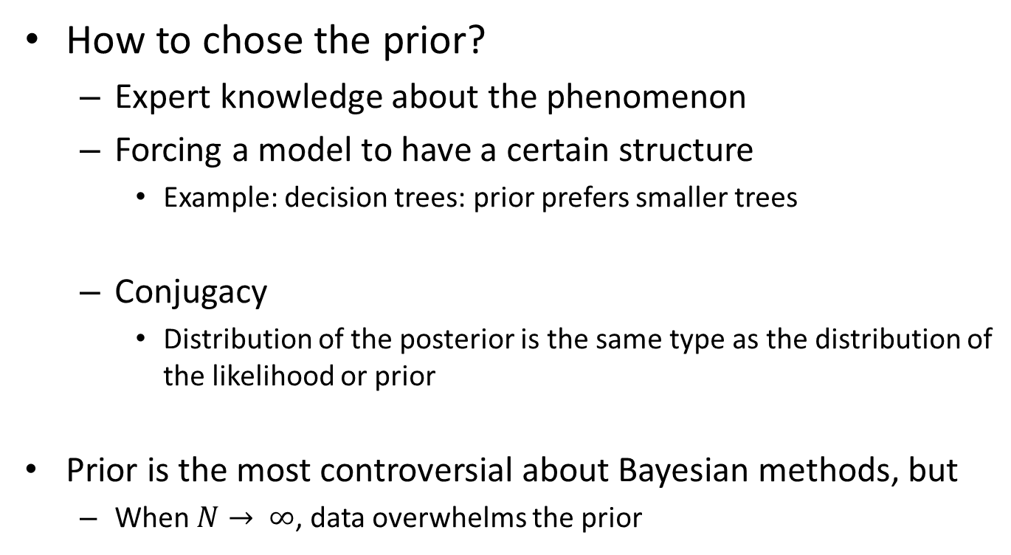
Fitting a model
How to chose the prior?
Expert knowledge about the phenomenon
Forcing a model to have a certain structure
Example: decision trees: prior prefers smaller trees
Conjugacy
Distribution of the posterior is the same type as the distribution of the likelihood or prior
Prior is the most controversial about Bayesian methods, but
When $N→ ∞$, data overwhelms the prior
http://en.wikipedia.org/wiki/Conjugate_prior

Slide 28
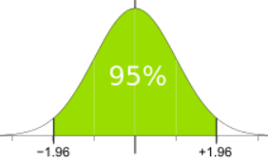
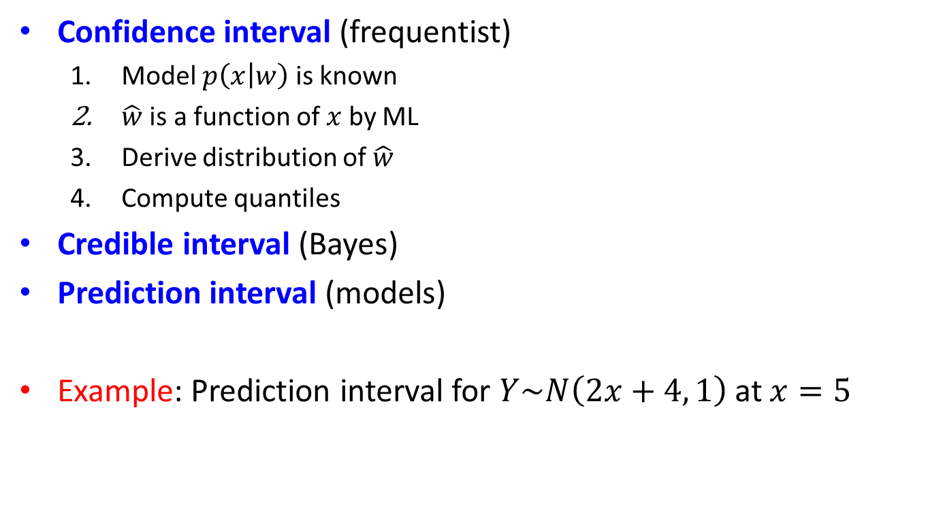
Measuring uncertainty
Confidence interval (frequentist)
Model $p\left(x | w\right)$ is known
$\hat{w}$ is a function of $x$ by ML
Derive distribution of $\hat{w}$
Compute quantiles
Credible interval (Bayes)
Prediction interval (models)
Example: Prediction interval for $Y\sim N\left(2x+4, 1\right)$at $x=5$

